Slide 1
System Design Document
For RMCH Unit

Slide 2
Overview
Remote Management Of Car Head Unit is a client-server system, The user of this system can use this system to manage several things for any car registered. Such as GPS location, milage / liter, engine heat signatures, OIL level, Batery life, Kilometer driven and also service due etc.

Slide 3
Requirements and Goals of the System
As per this new requirement we have to provide a new feature to the client called
Parental controll. Below are the list of functional and Non-Functional requirements
Functional Requirements:
Users should be able to set parental control using a self-service portal.
Users should be able to get alert message when car / vehicle starts.
Users should be able to disable the alert / notification service at any time.
Non-Functional Requirements:
The system should be highly reliable, once user data is set it should not be lost.
The system should be highly available. The system should be up and running at any point in time for the user to not miss the notification.
Users should get Realtime data without any lag.
Not in scope: Vehicle tracking.

Slide 4
Assumptions
There is already a working client-server application which supports other monitoring features for car head unit.
The self-service portal is already available for the user.
The car owners are using other features to access car health, censor information and GPS information etc.
The application is already deployed in cloud.

Slide 5
System APIs
We can have SOAP or REST APIs to expose the functionality of our service. The following could be the definitions of the APIs for setting vehicle secrity configuration:
~~/securityconfig/
[POST message] with request body containing details.
setSecurityConfig(api_token, user_id, title, description, locations[], notification_type, message_language, notification_details, message_contents)
Parameters: api_token (alphanumeric): This is a token given / set in user's device when user registers with the app and logs in first time. User_id (string): This is the user id of the client / user title (string): Title of security configuration. description (string): Optional description of security configuration. locations (string[]): list of locations which is allowed by user. notification_type (string): Type of notification , e.g., Mail, WhatsApp, Text Message, etc. message_language (string): For example English, Hindi, (Any local language), etc. notification_details (string): How many receipients, retry till stop message or time limit, frequency, escalation, etc. message_contents (string): Prefered message needs to be sent.
Returns: (string) A successful registration will return HTTP 201 (request successful) and a message to the user with all the notification details.

Slide 6
High Level Design
At a high-level we would need the following components:
Processing Queue: Each gps / sensor data will be pushed to a processing queue to be de-queued and immediately processed by stream processing system.
Metadata DB: The database would save user specific rules and other details on notification service to work.
Cache: The cache would have latest user specific rules loaded from DB to support the streaming consumer/ stream processor
Notification Service: we need a new service which reads / processes the stream of gps data for a specific car-id and rule-id
Stream processor: We need high speed stream processing system for reading and processing data in milliseconds time interval.
Batch Processor: We also need batch processing system to analyze the stream of events for reporting etc.
Load Balancer: We need Load Balancers as we would have a scaled up version of our services for high availability.
Secure Network: We would need a secure network.

Slide 7
Database Schema
Notification rules metadata storage - MySql / MongoDB
Notification Rule Table | Notification Tracker | User
User Id Rule Id Car / Vehicle Id Title Description Recipients Message Language Message Text frequency Escalation matrix Notification Stop criteria Location | Rule id Notification sent time Notification acknowledgement time Notification acknowledge by recipient Number of retries | User ID Name Email Address Age registration details, etc.

Slide 8
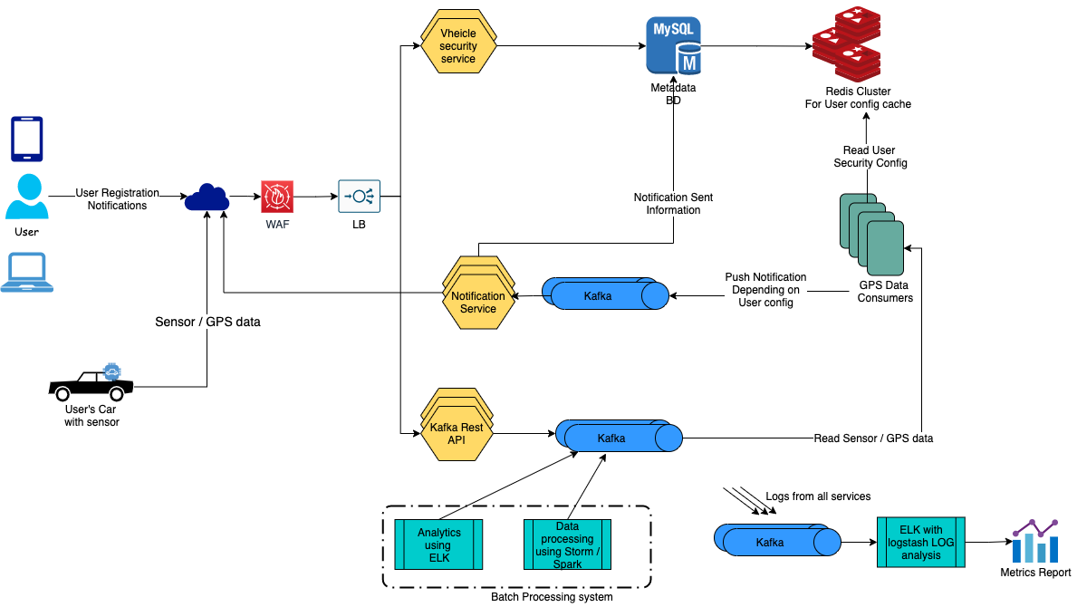
System Architecture Overview

Slide 9
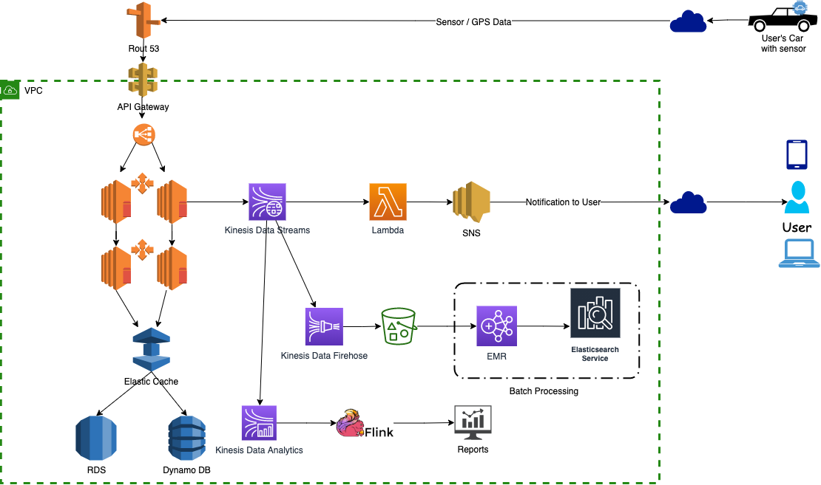
System Architecture Overview - AWS

Slide 10
Operational Details
How to achieve Non Functional requirements
High response time
Using Kinesis gives us ability to process thousands of records per Shard.
Lamda is auto scaled and can support processing speed of Kinesis same goes for SNS service.
Redis cluster provides high throughput cache.
High Availability
As the system overview depicts we have Elastic load balancer in place. We are going to spawn multiple datacenters in different availability zones with cross region replication.
Replication of both Kinesis data streams and Redis cache.
Dynamo DB / RDS are highly available and scalable databases.
Security
VPC secures all the internal communication.
For the user to set Rules uses the API Token which is provided and set in user's device at the time of user registration and logging in to application.
** There are many Vehicular cloud computing solutions which provide secure communication between vehicle and server**

